Slide 1
Sales and Finance Report of AtliQ Hardware
Using Advanced Excel and Power Query
Presented by: Janaki Patel

Slide 2
Content
Introduction
Project Objective
Tools Used
Data Model & DAX Measures
AtliQ Sales and Financial Reports

Slide 3
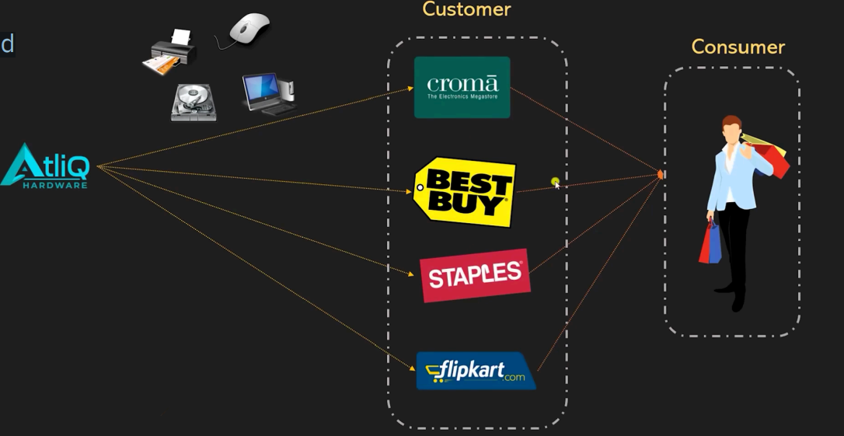
Regarding AtliQ and its Business model...
AtliQ Hardware, a dynamic player in computer hardware and peripherals, caters to major clients like Amazon, Flipkart, Neptune, Croma, and its own e-stores, utilizing various channels such as direct, retailer, and distribution.

Slide 4
𝗣𝗿𝗼𝗷𝗲𝗰𝘁 𝗢𝗯𝗷𝗲𝗰𝘁𝗶𝘃𝗲
Expertise a comprehensive sales and financial report analysing AtliQ Hardware's market performance for the years 2019, 2020, and 2021, furnishing valuable insights for informed decision-making.

Slide 5
Tools Used
Power Query (Cleaning and Combining data)
Data Modelling
Pivot Table & Power Pivot
Conditional formatting
Dax Measure

Slide 6
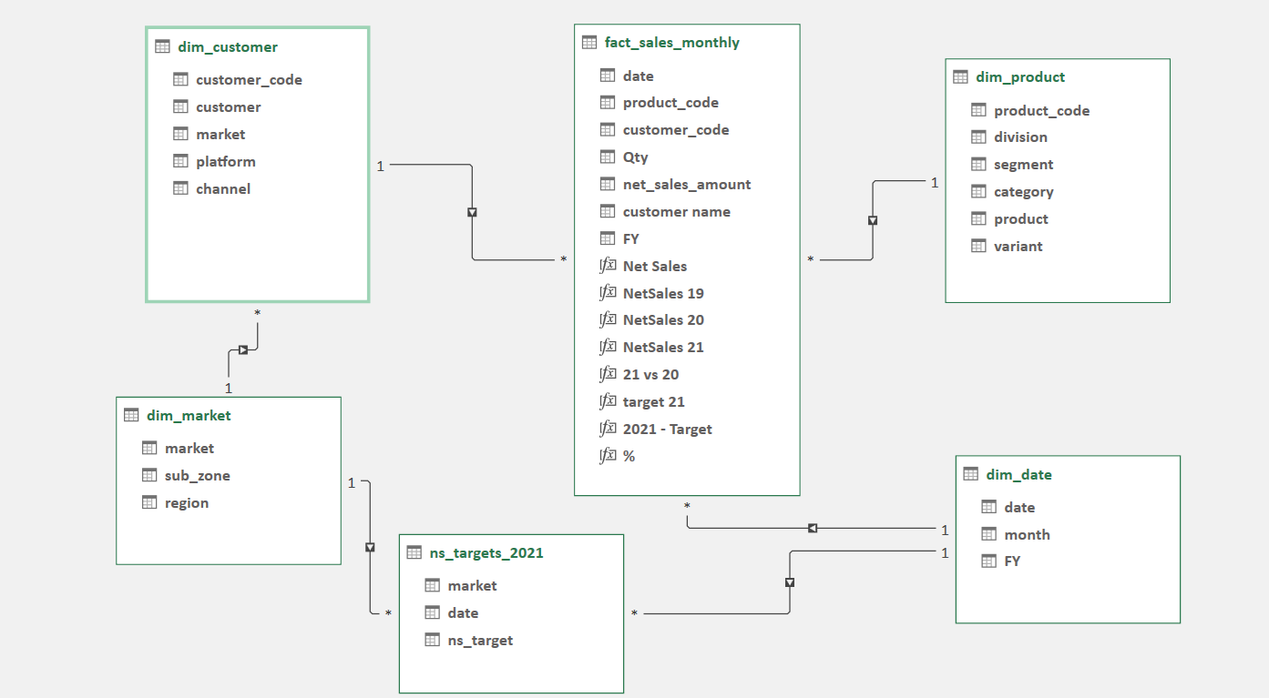
Data Model

Slide 7
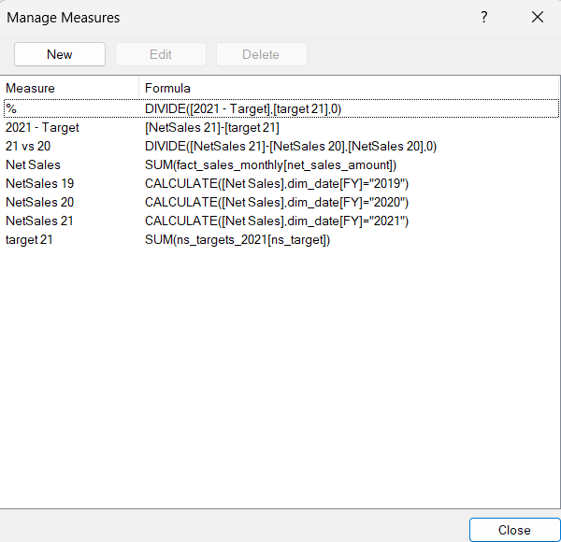
DAX Measures

Slide 8
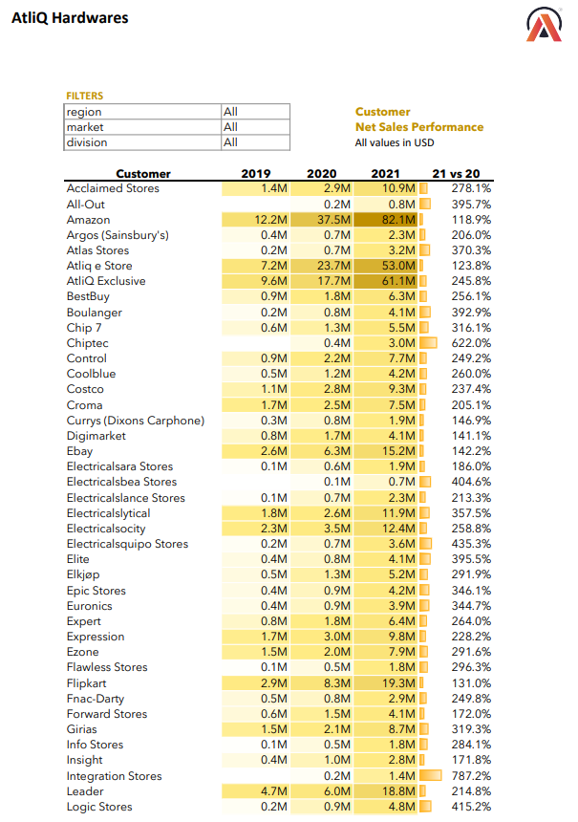
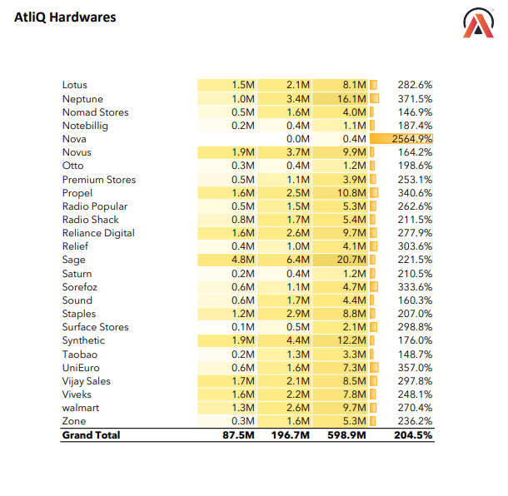
Customer Performance Report

Slide 9
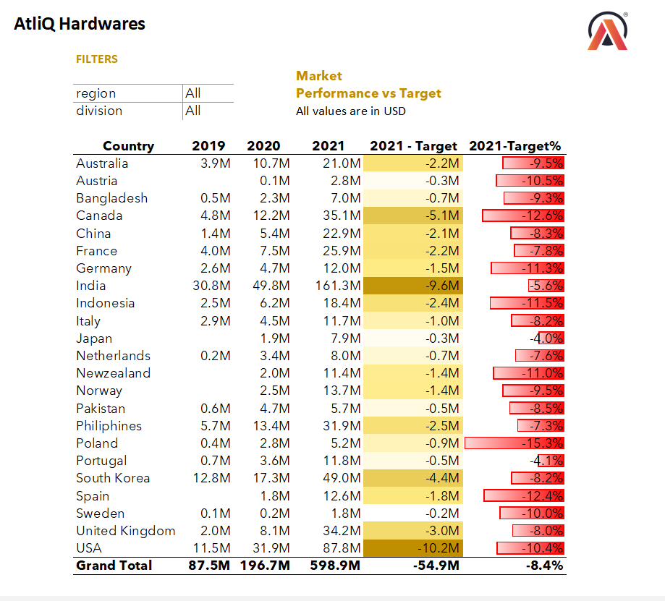
Market Performance vs Target

Slide 10
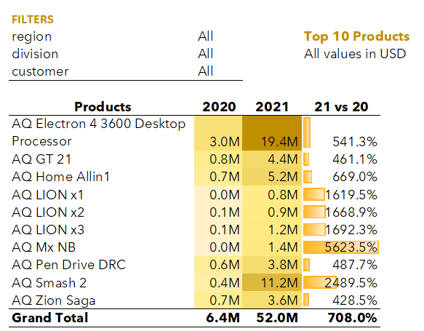
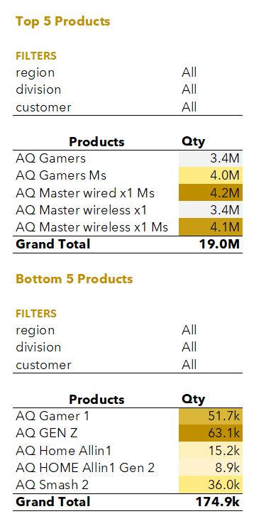
Top and Bottom Products

Slide 11
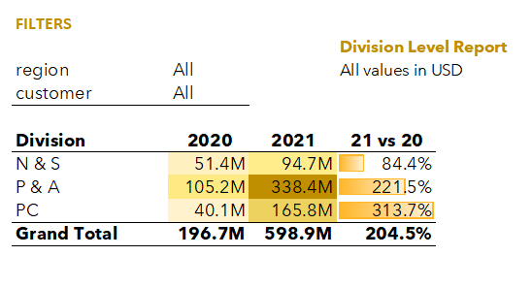
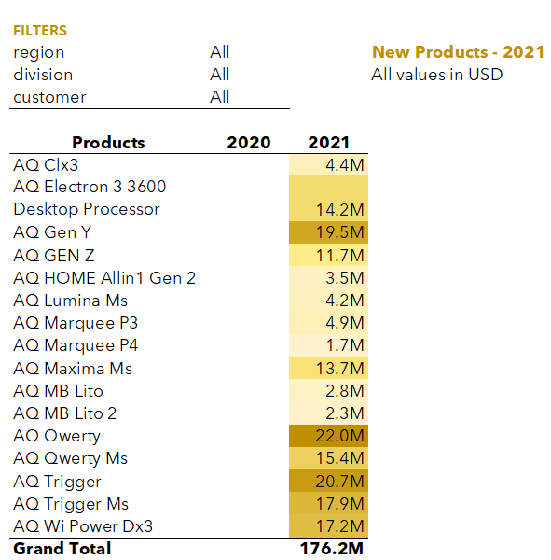
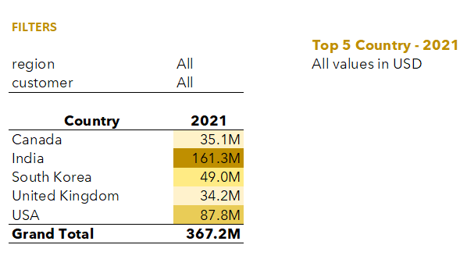
Division , Top 5 Countries and New Product Expansion

Slide 12
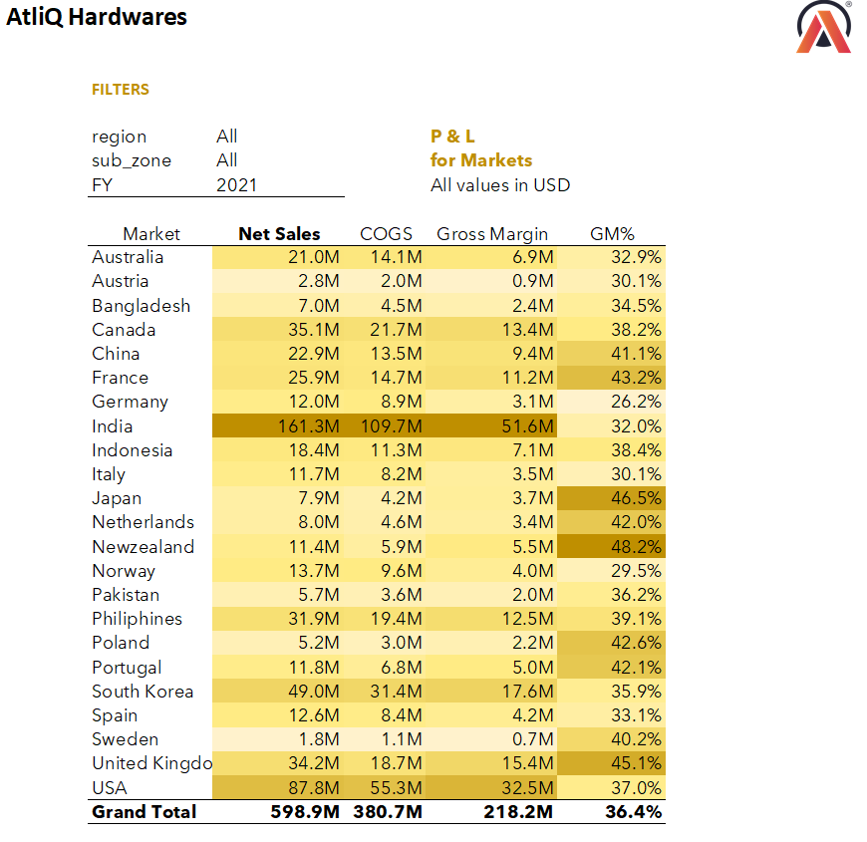
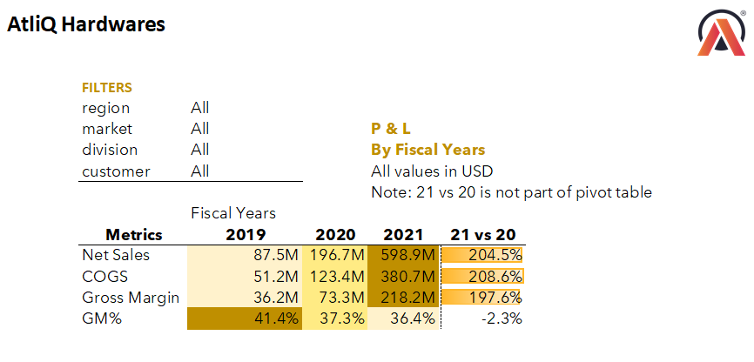
P&L Statement by Fiscal Year and Markets

Slide 13
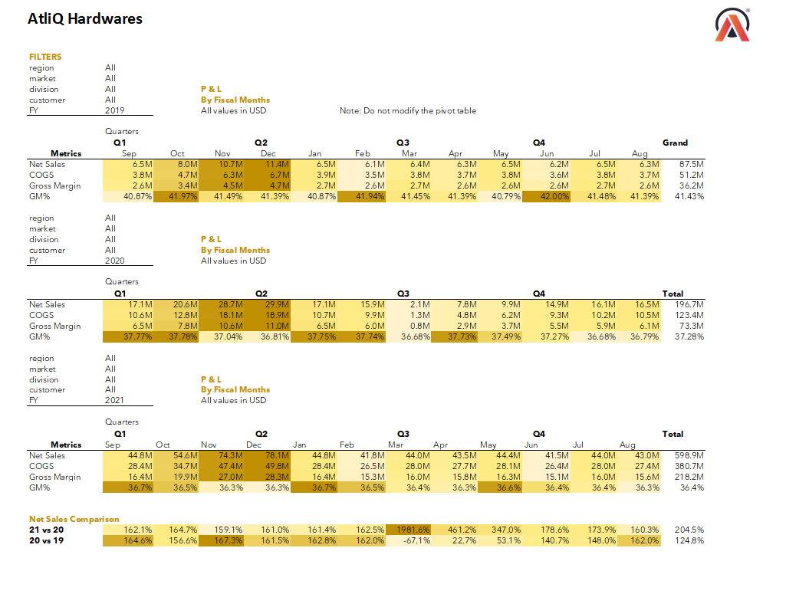
P&L Statement BY Months

Slide 14
Valuable Insights
Amazon emerged as the top customer with net sales of 82.1 million USD in 2021, followed by AtliQ Exclusive and AtliQ e-store.
India led in net sales, amounting to 161.3 million USD in 2021.
AQ Mx NB Product had the highest percentage increase in net sales from 2020 to 2021.
Significant sales spikes, particularly from October to December.
16 new products were introduced in 2021, with AQ Qwerty leading sales at 22 million USD.
The P&A division recorded the highest net sales, totalling 338.4 million USD in 2021.

Slide 15
T H A N K Y O U

